Slide 1
Home automation ≈ smart home
Adam Votava

Slide 2
IoT
17b devices, 2x by 2030
Collection of data
Communication with other devices
Remote control
smart homes, smart cities, transportation, healthcare
Ocean of things, internet of battlefield things

Slide 3
Lighting Control
Climate control
Security and surveilance
Home entertainment
Appliance control

Slide 4




Home automation systems

Slide 5
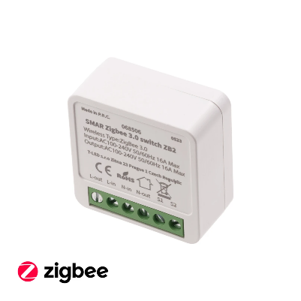

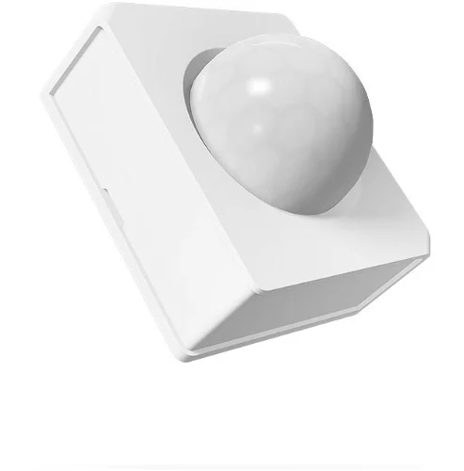
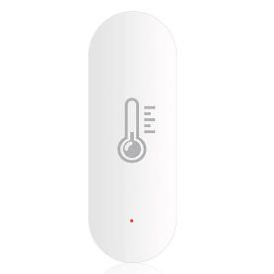
Low-power
Mesh networks
Coordinator, router, end device

Slide 6
Security
Passwords
Update firmware
Limit remote access

Slide 7
vocabulary
Versatile – seful for different purposes
Integrate – combine more things to form a whole
Scalability – the capacity to be changed in size or scale
Protocol – set of rules
Presence – the fact that someone or something is in a place

